Slide 1


data analytics on the Wavemaker project
Jie Liu

Slide 2



agenda
Problem Analysis
Model Building
Discussion
Data Preparation (ETL)
Model Evaluation
Notes:
This is the presentation agenda.

Slide 3
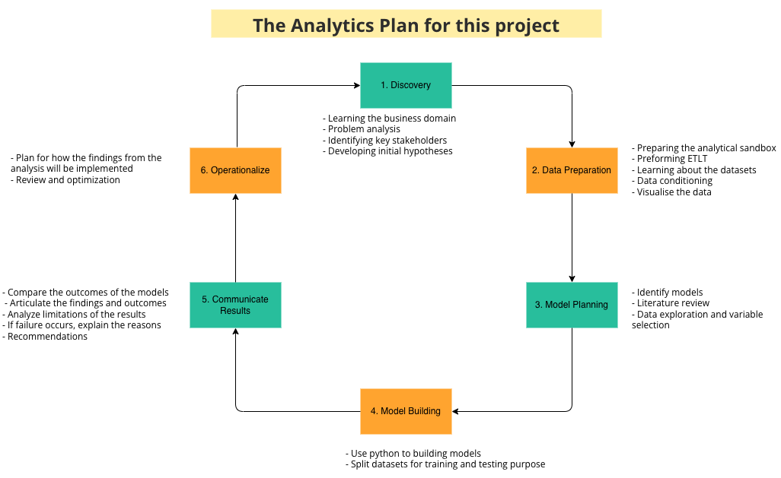
problem analysis – Analytics plan

Slide 4

Problem analysis
Purpose
Key stakeholders
Initial hypothesis - Potential factors affecting a user's purchasing behavior
User's gender
User's age
User's salary

Slide 5
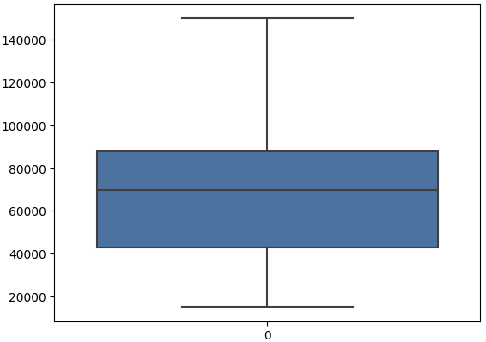
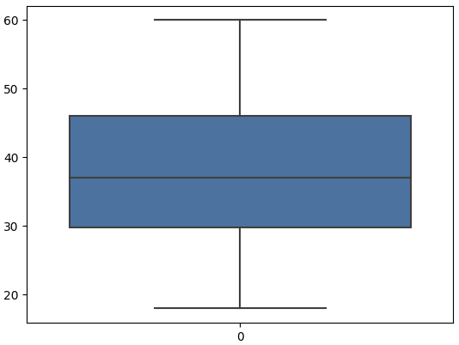
data preparation
Missing values
Duplicates
Outliers
Convert the gender to numerical values using one-hot encoding

Slide 6
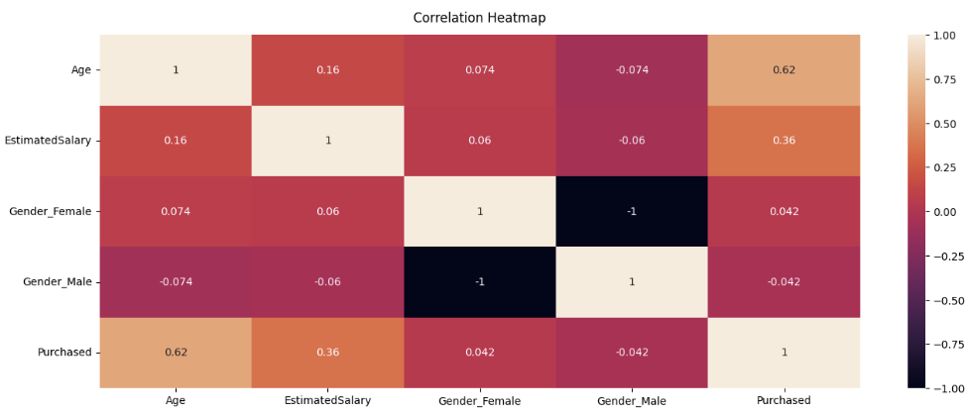
data preparation
Explore the correlation of different variables & feature selection
Notes:
Multicollinearity problem

Slide 7
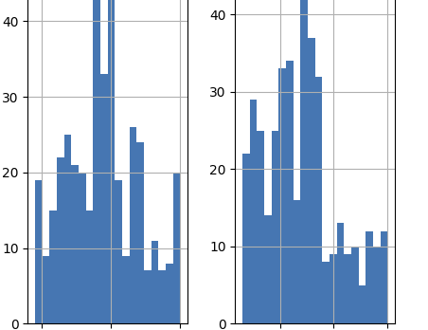
data preparation
Data visualization
Class imbalance problem
Class 0: 257
Class 1: 143

Slide 8
Model building
Shuffle
Split the dataset
Standardize the data
Deal with class imbalance issue

Slide 9
Model Evaluation
 | Logistic Regression | Gaussian Naïve Bayes
Accuracy | 86% | 95%
Precision | 81% | 91%
Recall | 84% | 97%
F1-score | 83% | 94%
ROC AUC | 86% | 95%

Slide 10
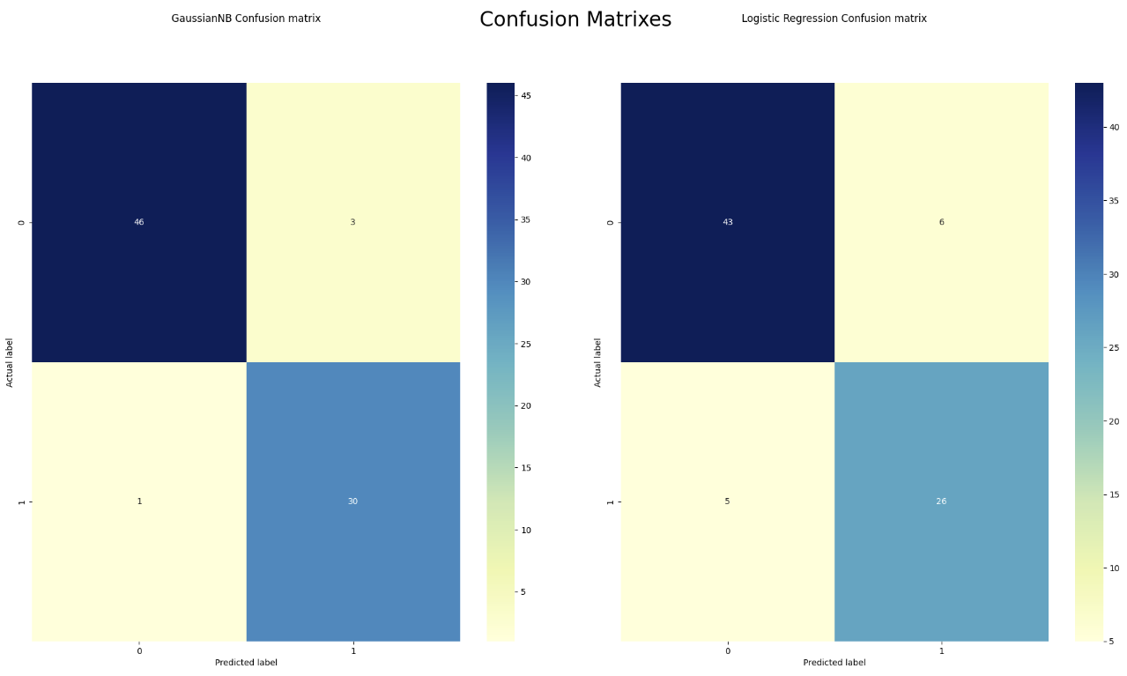
Model evaluation

Slide 11
discussion
Logistic regression equation:
logit(P) = -0.512127983256144 + 0.17779686582053025 * Gender_Male + 2.103933200467163 * Age + 1.0358402974253895 * EstimatedSalary
Two models both perform well on the dataset. However, the Naive Bayes classifier is more accurate and reliable
In the future, I will explore other classification models including Random Forest, Decision Tree and Gradient Boosting Machines (GBM) to make predictions on this dataset.

Slide 12


Thank you

